Slide 1

INTRODUCTION TO “MICROSOFT POWER BI” & ADVANTAGES OVER TRADITIONAL ERP REPORTING SYSTEMS
Analyzing the Benefits of Modern BI Tools in Business Decision-Making
Traditional ERP reporting often lacks flexibility, real-time insights, and user-friendliness. Microsoft Power BI offers a modern BI solution with interactive dashboards, AI-driven analytics, real-time data access, and strong security empowering organizations to make faster, smarter decisions while ensuring data governance and enabling users across all levels.
BI For Business | April 2025
🌐 biforbusiness

Slide 2


You Will See
Overview
Brief Overview of Power BI as a Modern BI Solution
Differences
Explaining the Advantages of Power BI Solutions over ERP-based Reporting Systems
Why this matters?
Importance of Advanced Data Analytics in today’s Businesses
🌐 biforbusiness

Slide 3




LIMITATIONS
of
ERP Reporting
Time-Consuming: Manual efforts required for data extraction and visualization
Static Reports: Limited interactivity and flexibility
Data Silos: Difficulty in integrating multiple sources
Limited Advanced Analytics: Lacks predictive insights and deep data exploration
🌐 biforbusiness

Slide 4
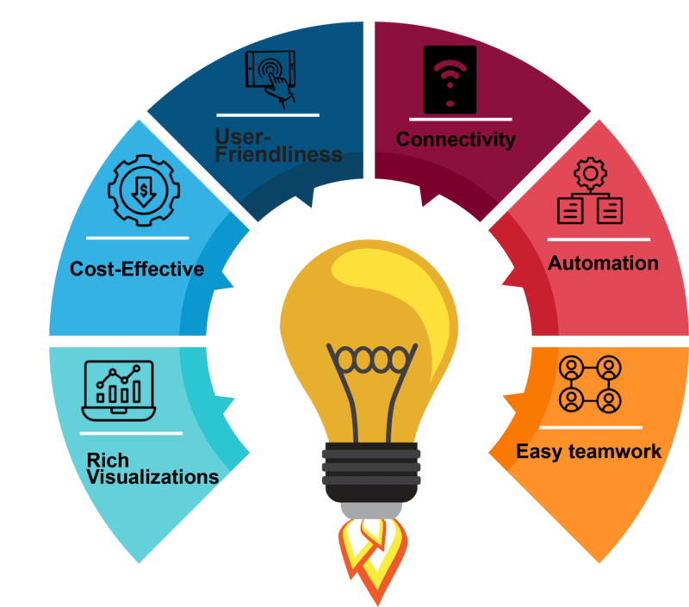
ADVANTAGES of
Interactive & Dynamic Reporting
Real-Time Dashboards and Self-service Analytics
Customizable Views with drill-down capabilities
BI Solutions
Data Integration & Centralization
Consolidation from Multiple Sources (ERP, CRM, Databases, Cloud Data Warehouse, Excel, etc.)
Eliminates Data Silos for holistic business insights
Advanced Analytics & AI/ML Integration
Predictive Analytics and Trend Forecasting
AI Features and Anomaly Detection
Time & Cost Efficiency
Reduced Manual Reporting Efforts
Faster Decision-making based on Real-time data
Enhanced Data Visualization
User-friendly graphs with Drag & Drop features
Improved storytelling through data-driven insights
🌐 biforbusiness

Slide 5
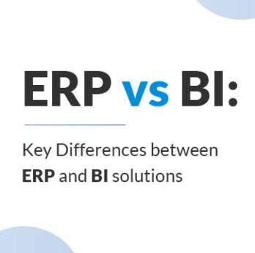
Comparisons
ERP
Vs.
BI Solutions
Business Intelligence (BI) solutions and Enterprise Resource Planning (ERP) systems serve different purposes but complement each other in business operations.
Feature | ERP Reports | BI Solutions
Data Refresh | Manual/Periodic | Real-time
Interactivity | Limited | High (Drill-down, filters)
Predictive Analytics | Rare | Advanced AI/ML features
Integration | Often siloed | Multi-source integration
Visualization | Basic charts | Advanced, interactive visuals
Cost Effective | High cost due to ERP licensing fees | Minimal cost (Starting with $14/month)
🌐 biforbusiness

Slide 6

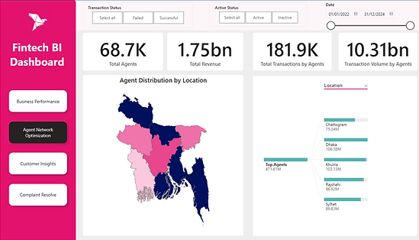
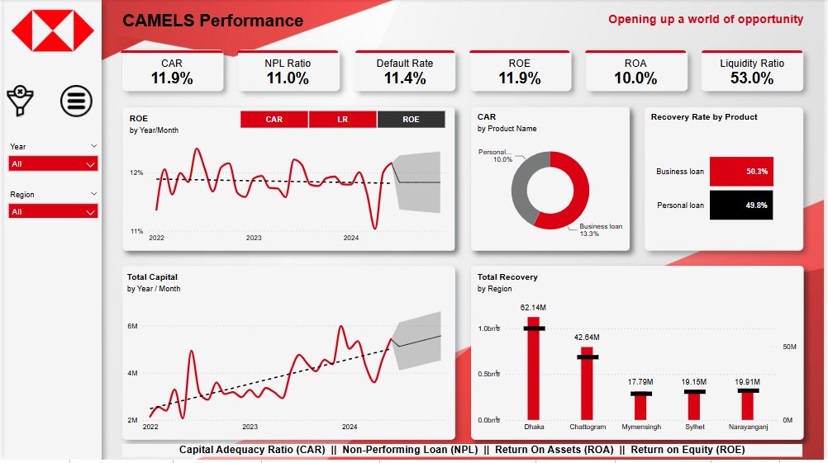
Real-world
APPLICATIONS
Examples of industries benefiting from BI
Click to view the report ↑
Click to view the report ↑
🌐 biforbusiness

Slide 7
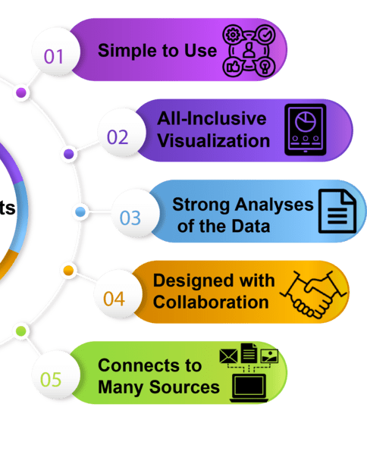
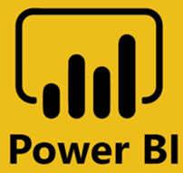
Why Power BI?
THE
Game-Changer
in BI
🌐 biforbusiness

Slide 8

From DATA
to
DECISIONS
Smart Dashboards that Update Automatically.
Predictive Analytics using AI (e.g., Forecasting, Key Influencers, Q&A Visual, etc.).
Visual Alerts when thresholds are crossed (Alerts & KPIs).
Ensuring Data Security & Governance with Role-based Access to Reports/Data
Drill-down capabilities for deeper insights.
🌐 biforbusiness

Slide 9

MONITORING
and
Alert System
Real-time Monitoring from Web Browser or Mobile App.
Alerts for KPIs like Sales drop, Inventory spike.
Email Notifications or Mobile Push Alerts.
Example use cases: Sales, Manufacturing, Finance.
🌐 biforbusiness

Slide 10

Intuitive drag-and-drop Report Building.
Natural Language Q&A ("Ask a Question about your Data").
Pre-built Templates and Dashboards
Integration with Excel and Teams
DESIGNED
for
EVERYONE
🌐 biforbusiness

Slide 11

Security & Governance Made Easy
Row-level security (RLS) for different User Roles.
Governance through Data Lineage, Usage Metrics.
Auditing Capabilities.
Compliance with Major Standards (GDPR, etc.)
🌐 biforbusiness

Slide 12

Connect to Everything You Need
Native Connectors: SQL, Excel, SharePoint, APIs, Salesforce, etc.
Streaming Datasets for Live Dashboards (IoT, Social Media, Sensors).
Power Automate for Workflow Integration
Hybrid Support (On-prem + Cloud)
🌐 biforbusiness

Slide 13
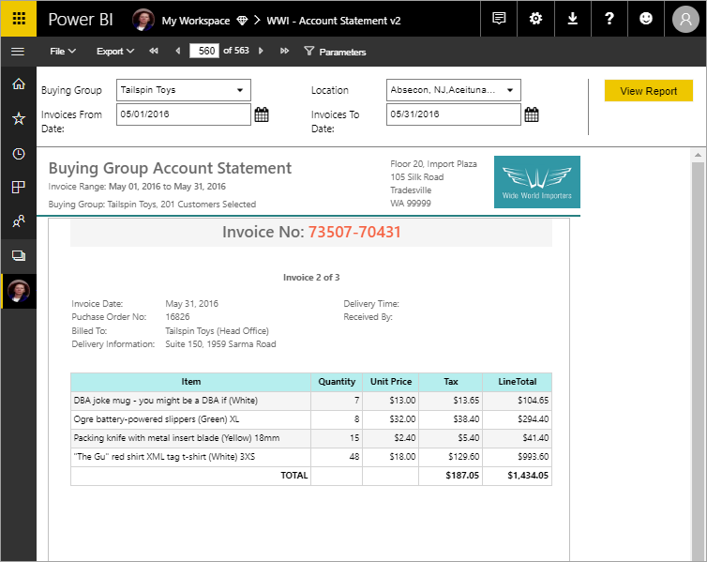
Paginated Reports & Exports
Pixel-perfect Formatted Reports.
Suitable for Finance, Invoices, Forms.
Export to PDF, Excel, CSV.
Email Subscriptions with Exportable Reports.
🌐 biforbusiness

Slide 14

Power BI Desktop – Free
Often a Free License is enough for Many Tasks
Power BI Pro – $14/user/month
Power BI Premium per user – $24/user/month
Premium Capacity – For enterprise scale
Value vs traditional BI tools: better ROI, scalable growth
Affordable & Scalable Licensing
🌐 biforbusiness

Slide 15

LIMITATATION OF ERP
ADVANTAGES OF BI
COMPARISONS
REAL WORLD EXAMPLE
POWER BI THE GAME-CHANGER
DATA TO DECISIONS
MONITORING
DESIGN FOR ALL
Security & Governance
EASY CONNECT TO ALL
PAGINATED REPORTS
LOW-COST LICENSING
🌐 biforbusiness

Slide 16


Thank you
Need Consultations?
🌐 biforbusiness

